Slide 1
EDGE COMPUTING IN NETWORKS

Slide 2
Introduction to Edge Computing
Definition:
Edge computing is a distributed computing paradigm that brings computation and data storage closer to the data source, or "edge" of the network, rather than relying on a central data center.
Why it Matters:
With the rise of IoT devices, the volume of data generated is immense. Processing data at the edge reduces latency, improves speed, and optimizes bandwidth usage, which is essential for applications requiring real-time processing.

Slide 3
Core Concepts
Latency Reduction:
Edge computing minimizes the physical distance that data must travel, which is critical for applications like autonomous vehicles and real-time analytics.
Bandwidth Efficiency:
By processing data locally, only relevant or aggregated information is sent to the cloud, saving bandwidth.
Privacy and Security:
Keeping data closer to its source can improve privacy and security, as sensitive data doesn’t have to travel over the internet to centralized data centers.

Slide 4
Applications of Edge Computing in Networks
Internet of Things (IoT):
Devices like smart cameras, industrial sensors, and wearables use edge computing to process data locally and send insights to the cloud only when necessary.
Telecommunications:
Telecom companies use edge computing to enhance 5G network efficiency by hosting applications closer to users in decentralized micro data centers.
Autonomous Vehicles:
Edge computing allows vehicles to process sensor data quickly, enabling real-time decisions without relying on the cloud.
Healthcare:
Wearables and medical devices that monitor health metrics in real-time utilize edge computing to alert doctors immediately if there's an anomaly.

Slide 5
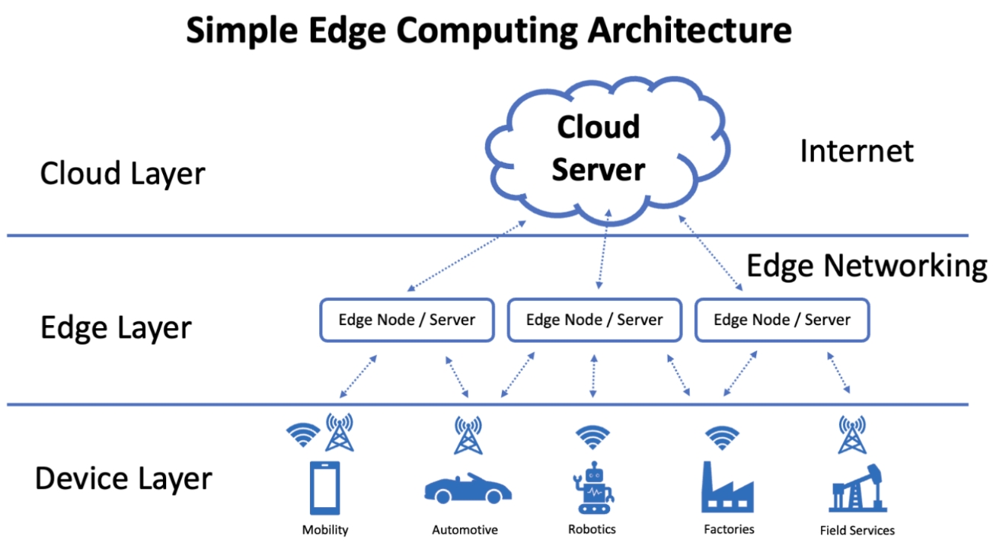
Cloud Layer: A central cloud server performs large-scale data processing and connects to the Edge Layer over the Internet.
Edge Layer: Distributed edge nodes handle data processing closer to devices, reducing latency and bandwidth by processing data locally before sending necessary information to the cloud.
Device Layer: Various devices (mobility, automotive, robotics, factories, field services) generate data and connect to nearby edge nodes for faster, localized processing.
Edge Networking enables data flow between devices, edge nodes, and the cloud server, optimizing response time and efficiency for real-time applications.

Slide 6
Challenges in Edge Computing
Scalability: Managing numerous edge devices can be complex and requires robust networking and management protocols.
Data Security: While data stays local, there’s a need to secure each edge device and node against cyber threats.
Interoperability: With diverse devices from different manufacturers, ensuring compatibility can be challenging.
Cost: Initial setup can be costly, as it requires investment in local processing power and maintenance.
Future of Edge Computing in Networks
AI and Machine Learning at the Edge: As processing power increases, more sophisticated AI models will run directly on edge devices.
Edge and 5G Integration: The combination of edge computing and 5G is expected to support low-latency applications, such as augmented reality and advanced IoT.
Smart Cities: Edge computing will be instrumental in smart cities, where vast amounts of data need to be processed in real time to manage resources and services efficiently.

Slide 7
THANK YOU

